Slide 1
Stock Market Analysis of Tesla, Microsoft and Apple
OGTIP Data Science 2023
Project 1
Kanan jabbarov

Slide 2
Agenda
Introduction
Descriptive Statistics
DATA Visualization
Regression analysis
Summary

Slide 3
Introduction
This project aims to create a statistical report that tracks real-time stock market data to analyze the performance of three major U.S. companies: Apple, Tesla, and Microsoft. The report also includes data on the S&P 500 index. The data sources used for this analysis are from Yahoo Finance, and we've recorded the daily stock values of these companies from 2018 to 2023.

Slide 4
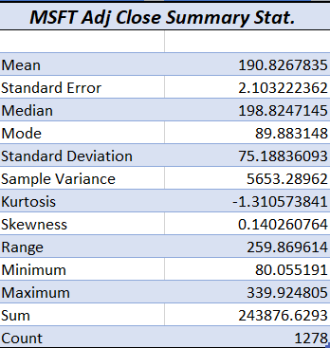
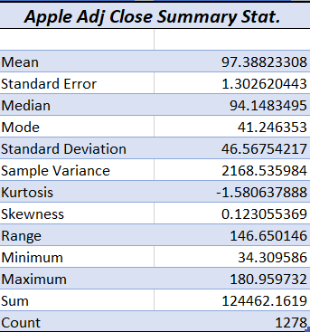
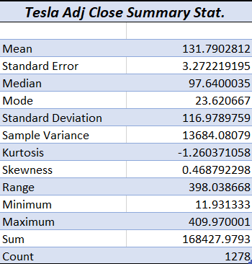
Descriptive Statistics for Adjusted Close Prices of All Stocks
Microsoft shows the highest mean price at $190 compared to Apple $97 and Tesla $131 .
Among the three companies, Tesla exhibits the most significant price range, with a minimum of $11.90 and a maximum of $409 While, Apple's price range is more moderate, ranging from $34 to $180, while Microsoft's prices vary between $80 and $339.
Apple boasts the lowest standard error of 1.3, reflecting the reliability of its average price. In comparison, Microsoft and Tesla exhibit slightly higher standard errors of 2.1 and 3.2, respectively, suggesting variations in their average prices.
Tesla exhibits the highest standard deviation of $117, signifying greater price volatility. In contrast, Apple's standard deviation is the lowest at $46.5, reflecting more stable price movements.
All three stocks have the negative kurtosis which implies less probability of extreme price movements. Additionally, the positive skewness results for these stocks indicate more frequent small increases in stock prices.

Slide 5
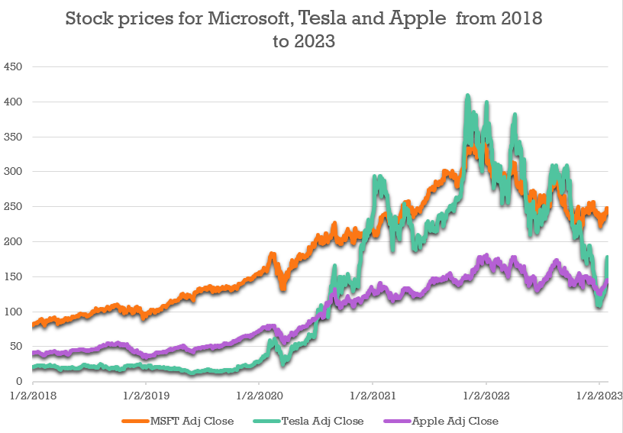
Descriptive statistics of stocks adjusted prices
Apple shows the lowest increasing trend compared to others on the other hand it has more stable fluctuations in stock prices.
Tesla depicts the massive growth among 2020 to 2022 and after shows decreasing trend which can indicates heightened risk and uncertainty in the stock.
Microsoft represents steady up trend over the period of 2018 to 2022 and then illustrates the mild negative direction.

Slide 6
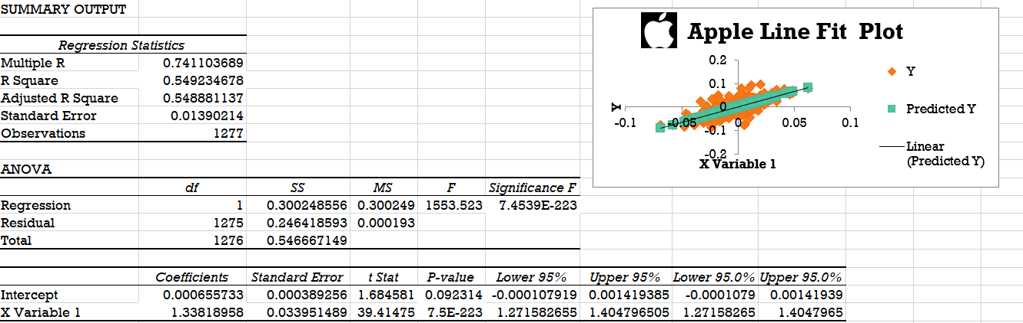
Regression analysis between apple and s&p500
The low Significance F value(7.4539E-223 ) shows the models performance indicating strong relationship between the Apple and S&P500 .
Apple has R-square of 0.5492 which shows approximately 54% of the fluctuations in Apple's stock price can be explained by changes in the S&P500.
The Beta coefficient of 1.3382 implies that a one-unit rise in the S&P 500 corresponds to approximately a 1.3382 -unit increase in Apple's stock prices.

Slide 7
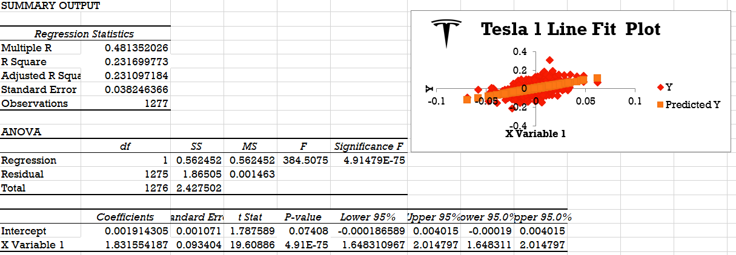
Regression analysis between TESla and s&p500
The extremely low Significance F value(4.91479E-75 ) indicates strong evidence supporting the existence of a definite relationship between the S&P 500 and Tesla in the model.
With an R-squared value of 0.2317, around 23.17% of the variation in Tesla's stock price can be attributed to movements in the S&P 500. This represents a significant portion of the variance that can be explained by the S&P 500.
The Beta coefficient of 1.8316 suggests that for each one-unit increase in the S&P 500, Tesla's stock price tends to rise by approximately 1.8316 units.

Slide 8
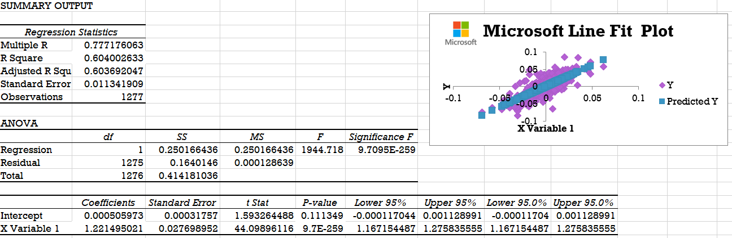
Regression analysis between Microsoft and s&p500
The nearly zero Significance F value (9.7095E-259 ) confirms the model's validity, indicating a non-random relationship between the S&P 500 and Microsoft's stock.
R-squared value of 0.6040 indicates that roughly 60.4% of the fluctuations in Microsoft's stock price can be attributed to changes in the S&P 500.
The Beta coefficient of 1.22 suggests that for each one-unit increase in the S&P 500, Microsoft's stock price tends to rise by approximately 1.22 units

Slide 9



Summary
Steady expansion and minimal fluctuations.
Moderate performance consistency with minimal variance.
Reasonable market reliance and reduced risk.
Elevated expansion with increased fluctuations
Fluctuating stock prices with heightened market responsiveness.
Increased opportunities for gains but also greater risk.
Follows market trends and maintains stable growth.
Evenly balanced performance with moderate fluctuations.
High correlation with S&P500, reflecting market-related risk.

Slide 10

Thank you

